Slide 1
COMP 51 Week Four
C++ Loops

Slide 2
Learning Objectives
Lab 2 Solution
Switch vs if-else
Indefinite Loops
While, do-while
Definite Loops
For loop
Nesting loops

Slide 3
Why Do We Care
Repeatability!
More program flow control options
Common feature in all programming languages

Slide 4
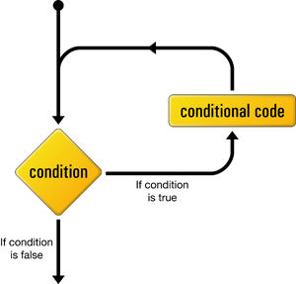
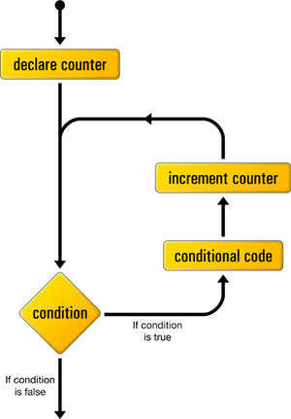
Getting Loopy 3 Types of C++ Loops
While Loop
Do While Loop (what’s different?)
For iteration loop
Notes:
while
Most flexible
No "restrictions"
do-while
Least flexible
Always executes loop body at least once
for
Natural "counting" loop

Slide 5
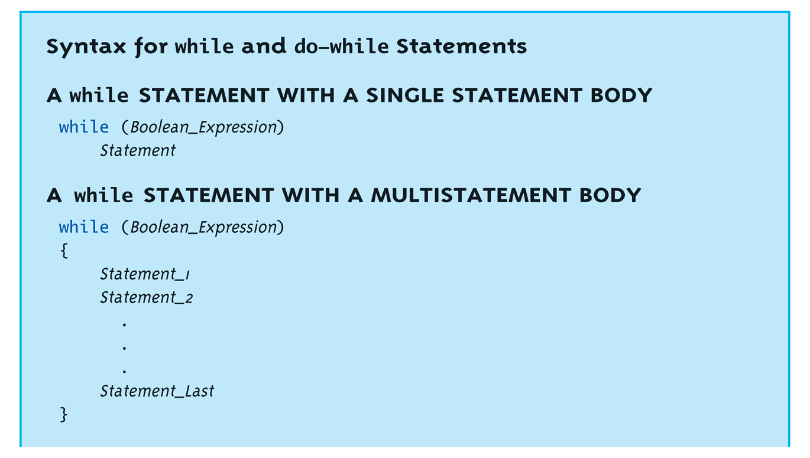
while Loops Syntax
The Boolean Expression makes this indefinite – we don’t know when it will stop

Slide 6
while Loop Example
Consider: count = 0; // Initialization while (count < 3) // Loop Condition { cout << "Hi "; // Loop Body count++; // Update expression }
Loop body executes how many times?

Slide 7
Practice Exercise Write the code for this flowchart
Are there more items
Ask user for number of items they ate
No
Yes
Ask user for number of calories for each item
Print total calories
End
Add current item calories to total calories

Slide 8
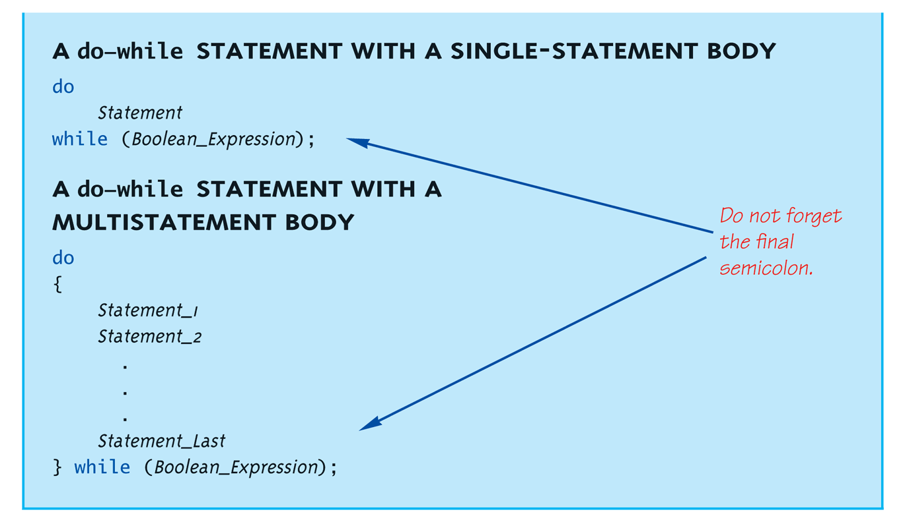
do-while Loop Syntax

Slide 9
do-while Loop Example
count = 0; // Initialization do { cout << "Hi "; // Loop Body count++; // Update expression } while (count < 3); // Loop Condition
Loop body executes how many times?
do-while loops always execute body at least once!
Notes:
Very similar, but…
One important difference
Issue is "WHEN" boolean expression is checked
while: checks BEFORE body is executed
do-while: checked AFTER body is executed
After this difference, they’re essentially identical!
while is more common, due to it’s ultimate "flexibility"

Slide 10
Practice Exercise do-while Input Validation
Track number of exercise push-ups
Assume person can do at least one pushup
After each push up, ask the person if they are tired. Assume Y or N char input
If they are tired, stop the pushups and print result

Slide 11

DeMorgan’s Law Testing for Bad Input
char light;
if (light == 'R') cout << "Stop!" << endl;
if (light == 'Y') cout << "Warning!" << endl;
if (light == 'G') cout << "Go" << endl;
// test for good inputs, reject if not good
if (! (light == 'R' || light == 'Y' || light == 'G')) {
cout << "Illegal value" << endl;
}
// test for bad inputs, reject any bad value
if (light != 'R' && light != 'Y' && light != 'G')) {
cout << "Illegal value" << endl;
}

Slide 12
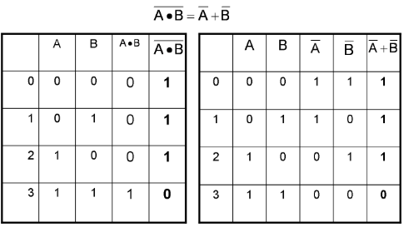
DeMorgan’s Truth Tables
||
&&

Slide 13
Practice Exercise Compound Logic Test
Write a loop that prompts the user to enter a number between 1 and 100.
Print out a message whether the number entered is odd or even. Hint – use the mod operator.
Exit the loop when they type an out of bounds number.

Slide 14
Comma Operator
Evaluate list of expressions, returning value of the last expression
Most often used in a for-loop
Example: first = (first = 2, second = first + 1);
first gets assigned the value 3
second gets assigned the value 3
No guarantee what order expressions will be evaluated.

Slide 15
Learning Objectives
Indefinite Loops
While, do-while
Definite Loops
For loop
Nesting loops

Slide 16
for Loop Syntax
for (Init_Action; Bool_Exp; Update_Action)
Body_Statement;
Like if-else, Body_Statement can be a block statement
Much more typical

Slide 17
for Loop Example
for (count=0;count<3;count++) { cout << "Hi "; // Loop Body }
How many times does loop body execute?
Initialization, loop condition and update all "built into" the for-loop structure!
A natural "counting" loop

Slide 18
Practice Exercise
Write a for loop that prints out even numbers between 12 and 23
Hint – the Update Action does not have to be i++

Slide 19
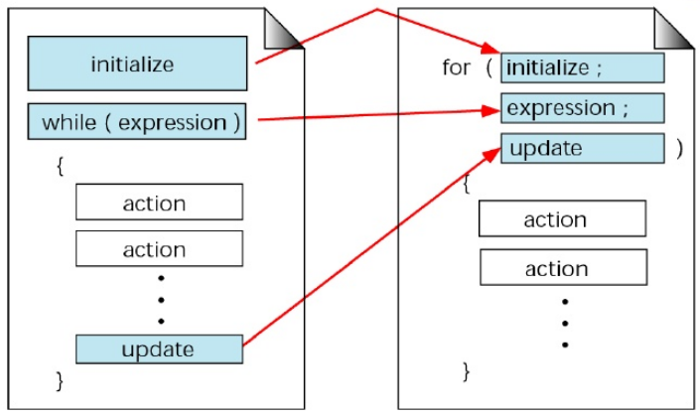
For versus While

Slide 20
Practice Exercise Loop Count Downs
Initialize variable
f = 1
I = 5
Decrement i
I > 0
Yes
f = f * i
No
Cout result
Calculate factorial

Slide 21
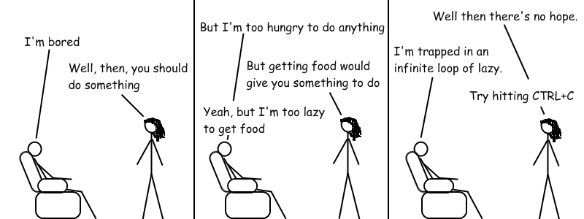
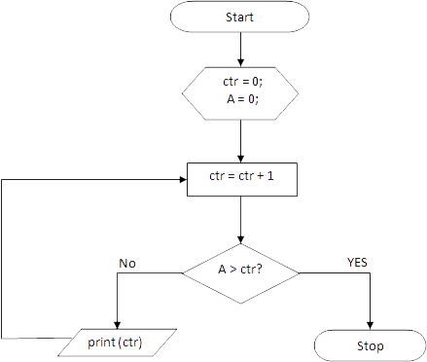
Loop Pitfalls
Infinite Loop – Condition statement is key and must evaluate to false!
Notes:
Loop’s condition expression can be ANY boolean expression
Examples:
while (count<3 && done!=0) { // Do something }
for (index=0;index<10 && entry!=-99) { // Do something }

Slide 22
Loop Pitfalls: Spot the Mistake
while (response != 0) ; { cout << "Enter val: "; cin >> response; }
Notes:
Note the ;

Slide 23
Loop Pitfalls : Spot The Problem
Example:
while (1) { cout << "Hello "; }
Notes:
A perfectly legal C++ loop → always infinite!
Infinite loops can be desirable
e.g., "Embedded Systems"

Slide 24
The break and continue Statements
Flow of Control
Recall how loops provide "graceful" and clear flow of control in and out
In RARE instances, can alter natural flow
break;
Forces loop to exit immediately.
continue;
Skips rest of loop body
These statements violate natural flow
Only used when absolutely necessary!

Slide 25
Forcing a Loop Exit
Useful for catching side effects
Invalid Input
Bad calculation (divide by zero)
Use break statement
while (I < 100) {
…
If (denominator == 0) break;
…
i++;
}

Slide 26
Practice Exercise Sum Up 4 Positive Numbers
Prompt user to enter numbers
Is count < 4
No
Yes
Input next number
Number > = 0
No
Print Total
Now redo the loop but allow the user to correct mistake
Yes
Add number to total

Slide 27
Nested Loops
Recall: ANY valid C++ statements can be inside body of loop
This includes additional loop statements!
Called "nested loops"
Requires careful indenting: for (outer=0; outer<5; outer++) for (inner=7; inner>2; inner--) cout << outer << inner;
Notice no { } since each body is one statement
Good style dictates we use { } anyway

Slide 28
Loop Iteration Table
Outer Loop Counter | Inner Loop Counter | Other Variables
0 | 7 | …
0 | 6
0 | 5
0 | 4
0 | 3
0 | 2
1 | 7
1 | 6
1 | 5
1 | 4
1 | 3
1 | 2

Slide 29
Practice Exercises
Write the steps to produce the following output (hint – use two for loops):
1
22
333
4444

Slide 30
Key Takeaways
Know the three types of loops
? _____________
Make sure that loops can exit or stop
But be careful about break and continue statements

